Slide 1

Dynamics 365 F&O Upgrade Tech Talk: Data

Slide 2
Synopsis
We’ll talk about how to upgrade or import your data to get from AX 2012 / 2009 to Dynamics 365 F&O. We’ll discuss the process to upgrade your data from AX 2012, how to write scripts for the upgrade and various odds and ends for your data like document attachments. We’ll also discuss the process to import your data from AX 2009, and Ops for code, data, environments, infrastructure, reporting and anything else technical.
PowerPoint available for download at https://github.com/NathanClouseAX/CommunityPresentations/tree/master/2021

Slide 3

Free Stuff
Gift Card Give Away!

Slide 4

Nathan Clouse
Technical Architect enVista Corp.
Microsoft Business Applications MVP
nclouse@envistacorp.com
www.atomicax.com
@NathanClouseAX

Slide 5

Sukrut Parab
Senior Architect Hitachi Solutions.
Microsoft Business Applications MVP
sparab@hitachisolutions.com
Sukrut Parab - Microsoft Dynamics Community
@SukrutParab

Slide 6

Topics
Upgrade Process
How to Upgrade your data
Troubleshooting
Writing Upgrade scripts
Notes:
NC: Start to trouble shooting
SP: From trouble shooting to end
NRC: Add notes on troubleshooting for SP

Slide 7

Upgrades – Why do I need this?
Your system is nearing the end of Microsoft support!
AX 2009
AX 2012
Mainstream support ended October 9, 2018
Extended support ends – April 12, 2022
AX 2012 RTM & R2 – Mainstream support ended Oct 9, 2018
AX 2012 RTM & R2 – Extended support ends April 12, 2022
AX 2012 R3 – Mainstream support ends October 12, 2021 (YESTERDAY)
AX 2012 R3 – Extended support ends January 10, 2023
End of mainstream support for Microsoft Dynamics AX 2009, Dynamics AX 2012, and Dynamics AX 2012 R2 - Finance & Operations | Dynamics 365 | Microsoft Docs

Slide 8
Process - 2009

Slide 9
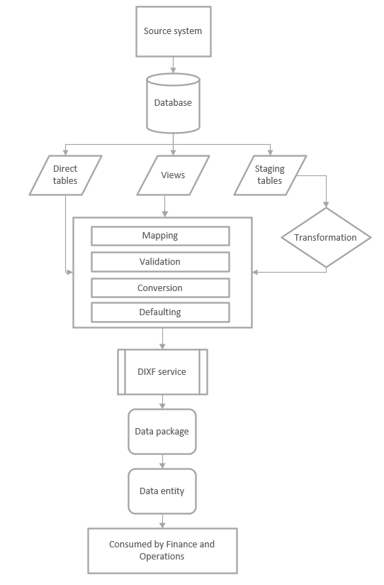
AX 2009 - Migration
Migrate Master Data
Transactions not included
Must install Data Migration Tool (DMT)
Installs DIXF for AX 2009
Currently in private preview
Have to ask MSFT for this
Links
https://dynamics.microsoft.com/en-us/migration-program/
https://microsoft.qualtrics.com/jfe/form/SV_brOLCioQ7mmeykB

Slide 13
Process - 2012

Slide 14

AX 2012 - Migration
Not Upgrading database
Don’t want transactions
Similar to AX 2009
Use Data Entities to export master data
Import into F&O using Data Entities
Notes:
This is to cover using DIXF in AX 2012 to export master data out to import it into 365
Most of my customers don’t do this but it’s an available option

Slide 15
AX 2012 - Upgrade
Want transactions
Bring all data from 2012 into F&O
AX 2012
Planning
Preparation
Cleaning
Prerequisites
Execution
Notes:
Typical upgrade path where we bring everything up
Planning – what you want to bring, what you want to clean up, what you want to get rid of
Preparation – cleaning the database of logs and posting data that is no longer needed like SalesParmTable records, journals from 7 years ago, all the production order journals from 7 years ago, so on
Cleaning – actually cleaning up your data using OOTB tools to clean up and keeping up with it throughout the project – monthly, quarterly, etc
Pre-requisites – what KBs you have to install
Execution – the process of upgrading

Slide 16
Questions
Where
AX 2012
PROD? UAT? Test?
A KB must be installed
D365 F&O
In Dev (T1) Environment?
In Cloud? Easier
Using on Prem VHD? Faster
UAT (T2+)
Cloud Only
What
Keeping all data model changes?
Re-writing a few?
Exploring what the process looks like with no customizations?
Notes:
Where – ax 2012 - how are you going to build your database upgrade pipeline? What will you use for the start of the process for discovery? What about for the actual go live event?
Where – 365 – where did you want to run the F&O portion of the upgrade. For defining the process, use a T1. Once you can successfully upgrade your data with no issues, look at changing it to use UAT. Database size is also an important factor.
What – what data are going to survive the upgrade? Are you getting rid of any custom fields or tables? Organizing some data structures. This is handled as part of the code upgrade but for anything that is different, it has to be accounted for in the code update. ie., renaming a table field will require an update script. However, fields with that same name will automagically be upgraded. You can also run the process with no cusotmizations just to see what kind of data issue you’ll have. And you will have some data issues you’ll have to resolve.

Slide 17
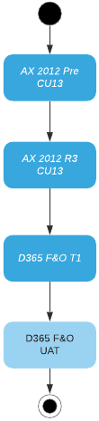
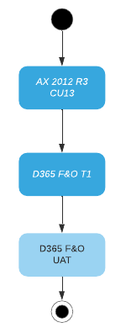
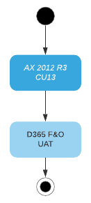
Diagram Of Options
Notes:
This is a diagram of potential options. The first is to take your 2012 R3 pre CU13 database, put it in an R3 Cu13 environment, upgrade the data to CU13, get it ready to upgrade to F&O, place in a T1 F&O environment, upgrade it, then export/import into UAT
The second is that “happy path” we’ll talk about which is to get it ready to upgrade to F&O, place in a T1 F&O environment, upgrade it, then export/import into UAT
The third option is to get it ready to upgrade to F&O, use SQL replication to replicate data to UAT then perform the upgrade in UAT.
Options 1 and 2 are fine for refining the process and also for going live. Option 3 is just for going live with a large database (14 GB bacpac compressed or larger)

Slide 18
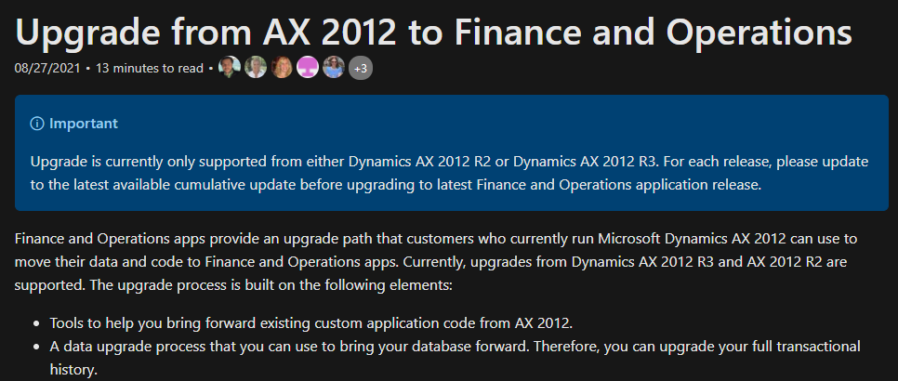
Notes:
MSFT has some double talk so the messaging isn’t clear. The docs say to upgrade to the latest version of R2 or R3, whichever is appropriate for your, then upgrade from there. This isn’t an easy thing to do in some instances.
However, ABSOLUTELY ALL VERSIONS OF R2 AND R3 ARE SUPPORTED for upgrade. MSFT has better support if upgrading from the latest but it will all still work if you’re not on the latest version. Nathan has upgrade an R2 RTM client with zero issues. Everything still worked as expected. Going to the latest version is suggested but NOT mandatory.

Slide 19
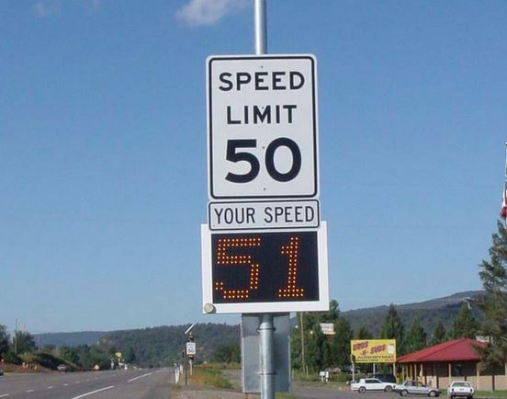
Notes:
Think of it another way. This sign says the speed limit is 50. will you drive exactly 50 or go a little faster? Weight the risk vs reward. If you run into major issues with whatever not-the-latest version of AX, you can upgrade you AX to address those issues. Be pragmatic with problem solving.

Slide 20
Process for Upgrading
How
Process is like AX 2009 to AX 2012 upgrade, if you’ve done that
Install AX 2012 KB
AX 2012 R3, install KB 4035163
AX 2012 R2, install KB 4048614
Run Prep Checklist
Backup AX 2012 Database and restore in D365 FO Environment with upgraded code
Run database upgrade package
MyTable.MyField in AX 2012 automagically maps to MyTable.MyField in F&O.
Any other data requires a data upgrade script
Notes:
High level process for upgrading

Slide 21
Pre-Execution
Prepare
Remove Unneeded / Unused ISVs
Before upgrade? During Upgrade?
Keep any Data?
Create Inventory of Customizations if you don’t have one
Know what is going to be upgrade and what isn’t
Have plan to upgrade data related to those customization
Remove Customizations not in use, if possible
Indexes
Can only add new ones now
Can’t change existing indexes
Notes:
Before you get started, it’s a good idea to remove any table/fields that are customizations that are no longer used from AX, if possible. Same with ISVs. If they aren’t in use, proactively remove them before upgrading rather than doing it as part of the upgrade, if possible. Or if you want to keep some data from an ISV that you plan to get rid of, plan out what you’ll be keeping in your own custom tables and fields.
If possible, create an inventory of customizations with supporting documentation for why it’s there. This will help with the code upgrade
Remove customizations if possible.
Look at all index changes. OOTB Indexes in F&O cannot be extended or modified. Review what has changed and determine if you’re going to have indexing issues

Slide 22
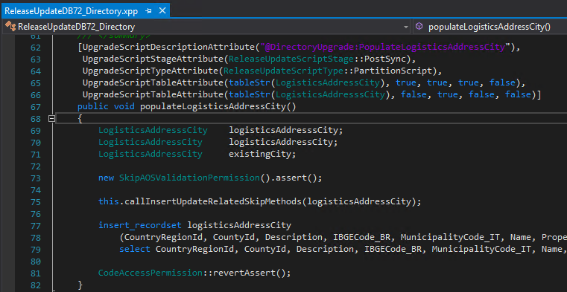
Correcting A Mistake? It’s OK!
Notes:
If you’ve made any coding mistake in the data layer, now is the time to fix them. Mistakes are ok. Look at this typo from MSFT that has existed for nearly 10 years. They fixed it AX 7. You can do something similar.

Slide 23
Pre-Execution
Clean
Run Cleanup Procedures
https://docs.microsoft.com/en-us/archive/blogs/axsa/cleanup-routines-in-dynamics-365-for-finance-and-operations
http://www.atomicax.com/article/full-database-cleanup-routine-part-1
Use database consistency check
System administration > Periodic > Database > Consistency check
Review Results using check option
Test / Review using fix option
Use by module / sub module
Notes:
Details around cleaning up your data.
Links to deep dive review / suggestions / how tos for this
Also, you should be using your database consistency check if you aren’t.

Slide 24
Execution
Install KB for your version
Start in 2012 Dev environment
Analyze fallout, make appropriate changes
Compile, CIL Compile
Obtain database backup from PROD
Restore into Dev environment, run appropriate scripts for back
Sync database
Run Pre-upgrade check list (System Administration > Setup > Checklists )
Run Pre-upgrade check list
Prepare model metadata
Prepare security role metadata
Setup user mapping
Converts from using local Active directory to use Azure Active directory
Will need users AAD login username; Contoso\SallyM vs SallyM@Contoso.com
Validate baseline version
Archive retail salt data
Notes:
Getting started with data upgrade – exploration phase to identify issues and resolve root cause. This will be an iterative process.

Slide 25
Last Step For T1
Backup prepared 2012 Database
Export as .bak file
Ideal if AOS(s) are stopped at time of export but not required for iteration testing process
Upload to Cloud Storage
SharePoint
OneDrive
LCS
Anywhere Secure
Notes:
The last step if you’re going to be starting the F&O upgrade in a T1 / Developer environment for F&O

Slide 26

Last Step For T2
We have options
Bacpac (small)
Dacpac (medium)
SQL Replication (large)
Notes:
If we’re going to continue in ann F&O UAT environment, we have 2 options to get the data there. A bacpac if the file is smaller than 14.7 gigabytes. If not, we’ll have to use SQL replication to transport the data from AX 2012 to F&O.
Using the data movement framework / DACPAC is technically still supported but all documentation for it has been removed from Microsoft docs

Slide 27
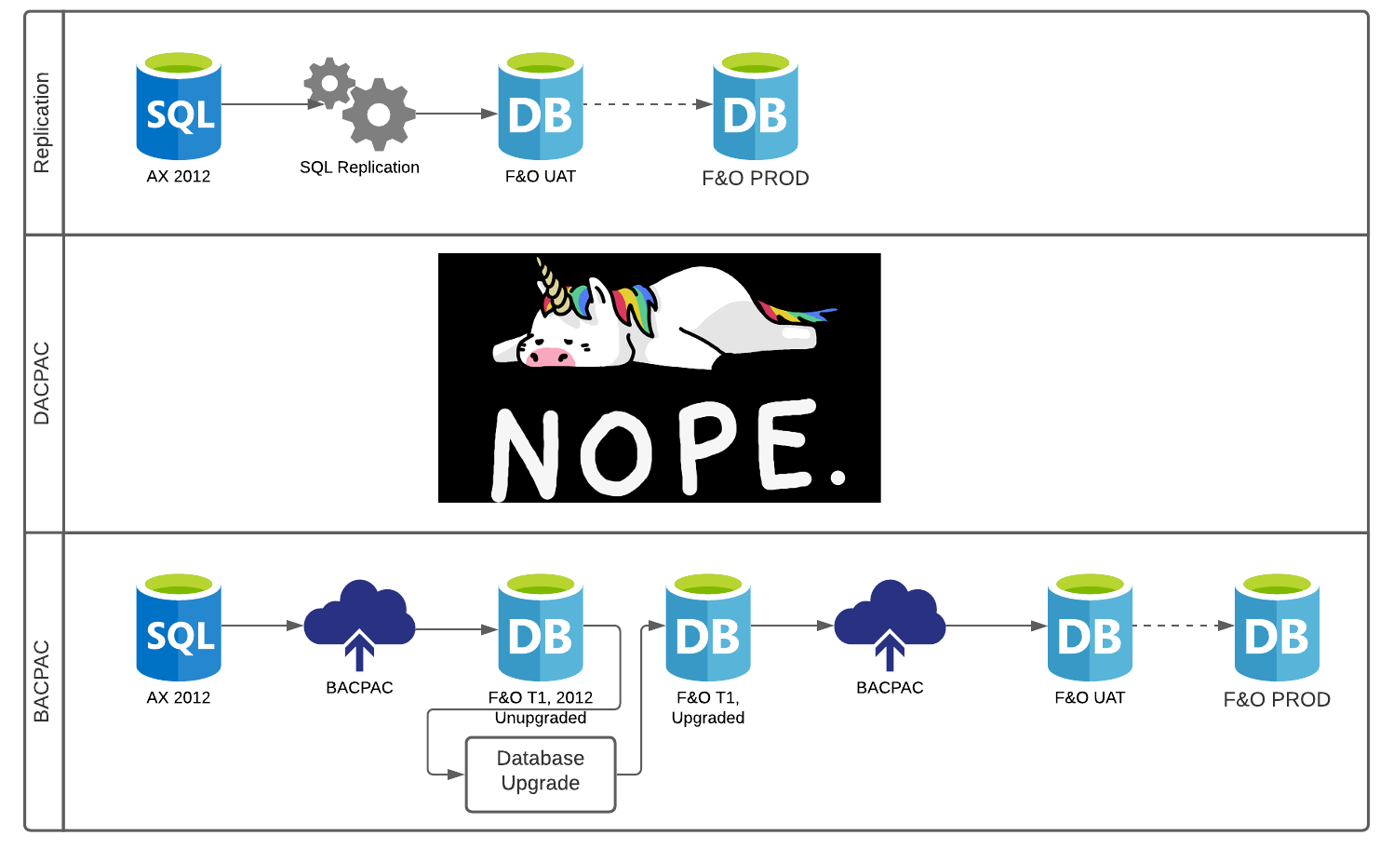
Notes:
High level diagram of the process

Slide 28
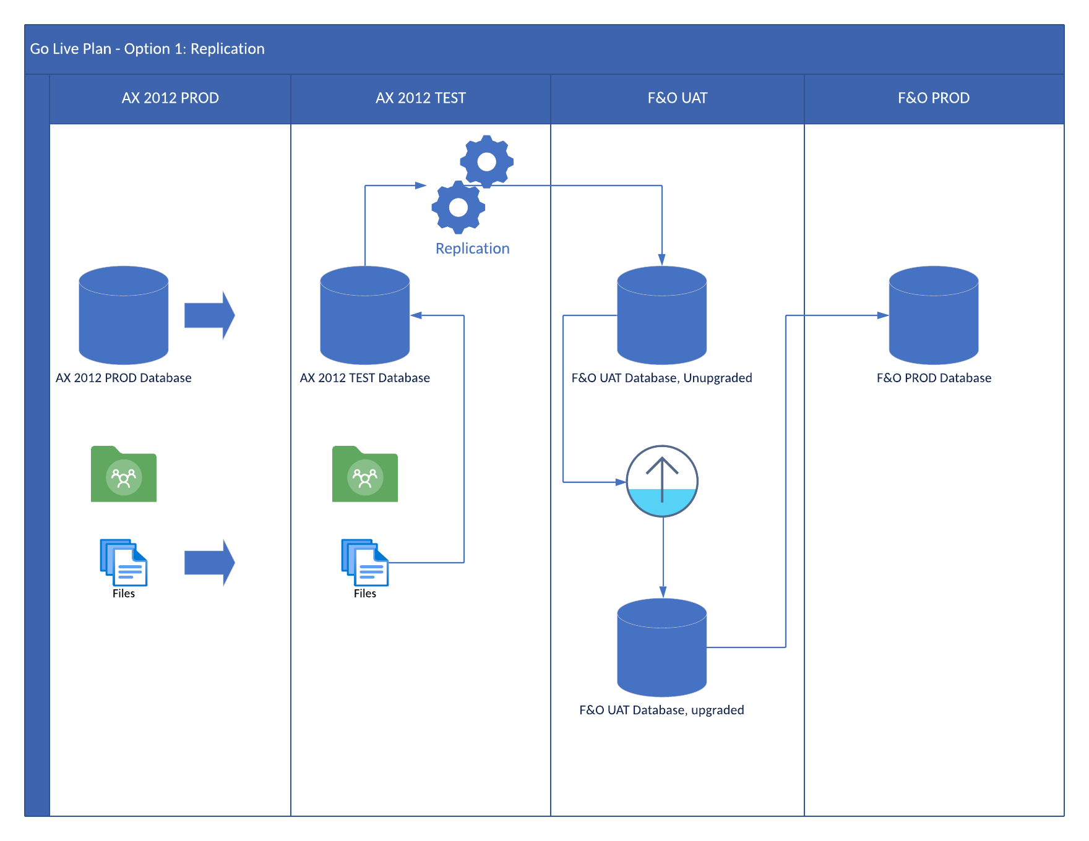
Notes:
Copy database form prod to test
Copy files from prod share location to test share location
Run KB in AX 2012 test
Use SQL replication to get data into F&O UAT
Run upgrade in UAT
Move the UAT database into PROD
NRC to just in with update on files if possible

Slide 29
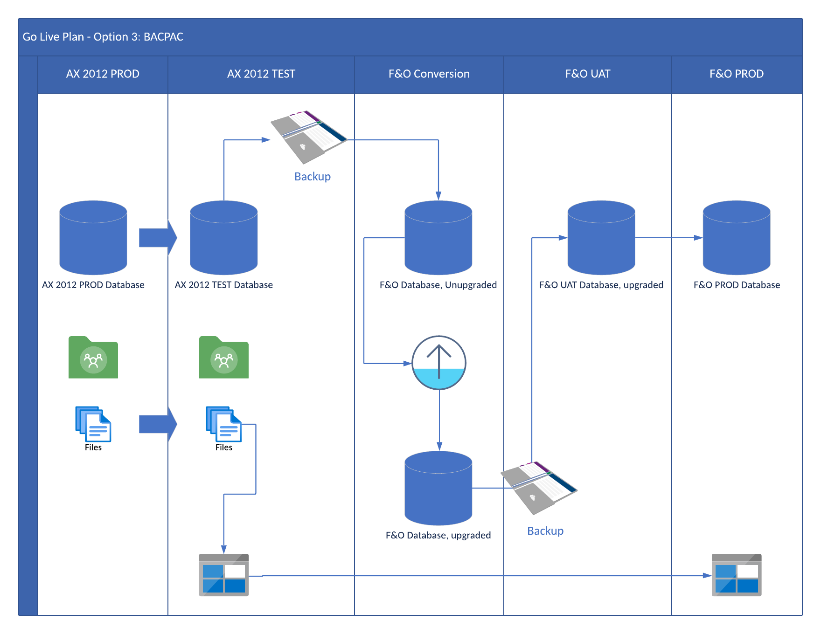
Notes:
Copy prod database to test
Copy prod fileshare files to test fileshare
Run KB in 2012 test
Backup AX 2012 test
Restore into F&O dev environment
Run database upgrade
Backup F&O Dev environment
Restore into F&O UAT (only an option for small sized database < 14.7G )
Promote database from UAT into PROD
NRC to chime in with update on file share migration process

Slide 30
Planning
Have F&O Setup
Demo Environment
Database Upgrade environment
Environment not used for active development
Should be connected to source control for updates between iterations
T1 Cloud is where we’ll focus
T2 option available for a refined database upgrade process
Notes:
When should the upgrade learning and discovery process start? After you have a demo environment and a development box to use for upgrade AFTER license purchase.
You should have at least 1 dedicated data upgrade vm / environment to for the discovery process, it should be hooked up to source control so it can get the latest code but no active development there outside of troubleshooting

Slide 31
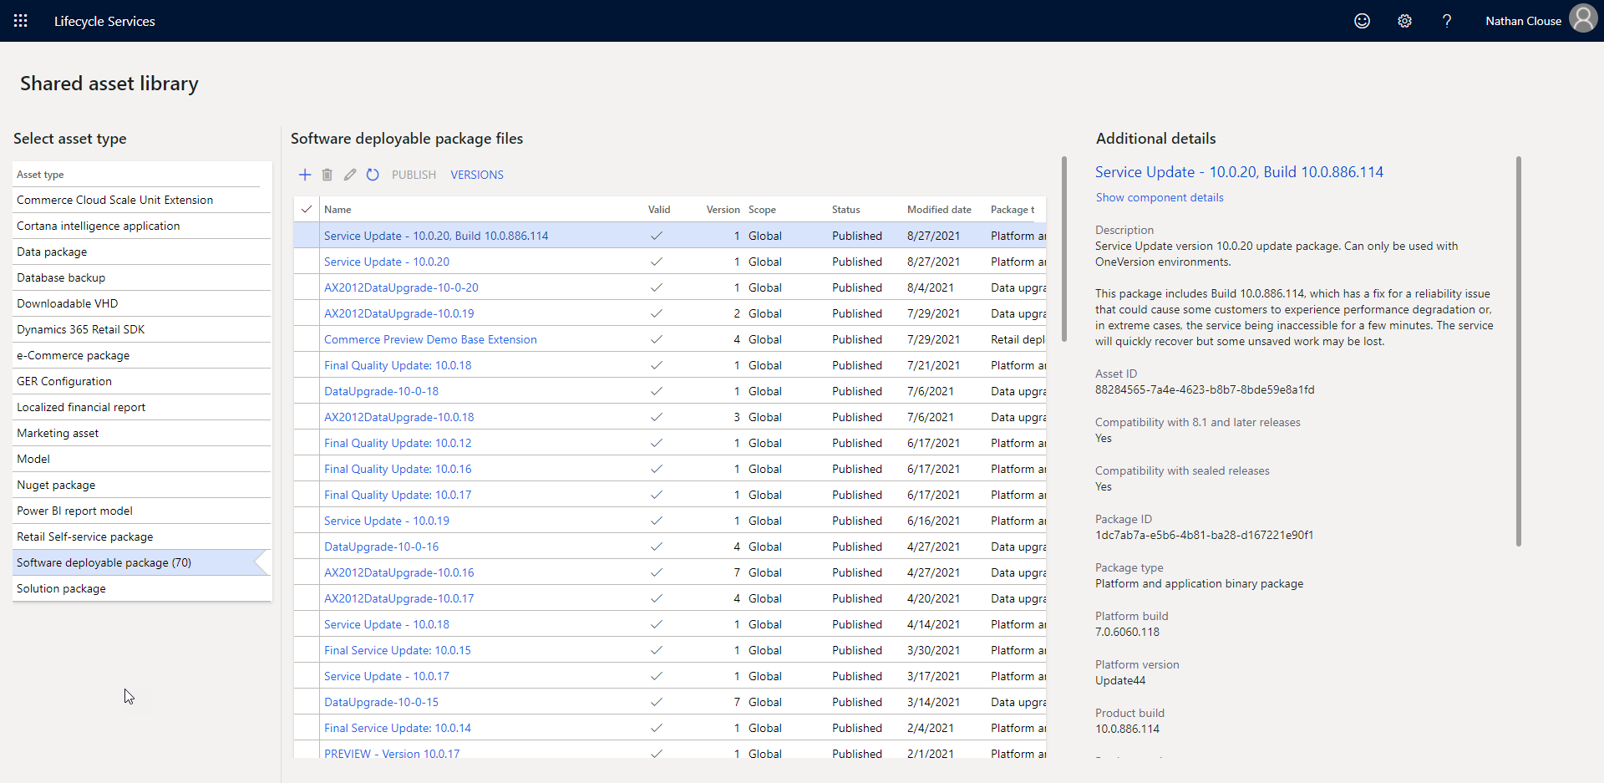

Slide 32

Explore in T1
Use D365FO.Tools
Find issues
Code Related
Missing upgrade scripts
Bugs
Database Related
Structure different
Different constraints in database
Data Issues
Bad Data
Remember all the direct SQL queries that weren’t SELECTs…

Slide 33
Execution
Stop all F&O related services in F&O Environment
Make sure environment has latest code; it builds and syncs
Run the upgrade deployable package
Using LCS for this emails people when it starts (and when it fails)
Use local package while working through issues
Suggest using Local Package
Download deployable package to VM, unblock and unzip, move into working directory
Use D365FO.Tools to create the runbook that will do the work

Slide 34
Invoke-D365SDPInstall -Path "C:\Temp\FNO10020DBUpgrade" -Command SetTopology
Invoke-D365SDPInstall -Path "C:\Temp\FNO10020DBUpgrade" -Command Generate -RunbookId 'UpgradeRunbook001'
Invoke-D365SDPInstall -Path "C:\Temp\FNO10020DBUpgrade" -Command Import -RunbookId 'UpgradeRunbook001'
Invoke-D365SDPInstall -Path "C:\Temp\FNO10020DBUpgrade" -Command Execute -RunbookId 'UpgradeRunbook001'

Slide 35
Suggestions - DevOps
Use unique Runbook IDs tied Azure DevOps work items
Report issues, bugs, and resolutions on that work item with references to other work items
Create follow up tasks related to that Runbook execution work item
Could use Iterations if you want

Slide 36
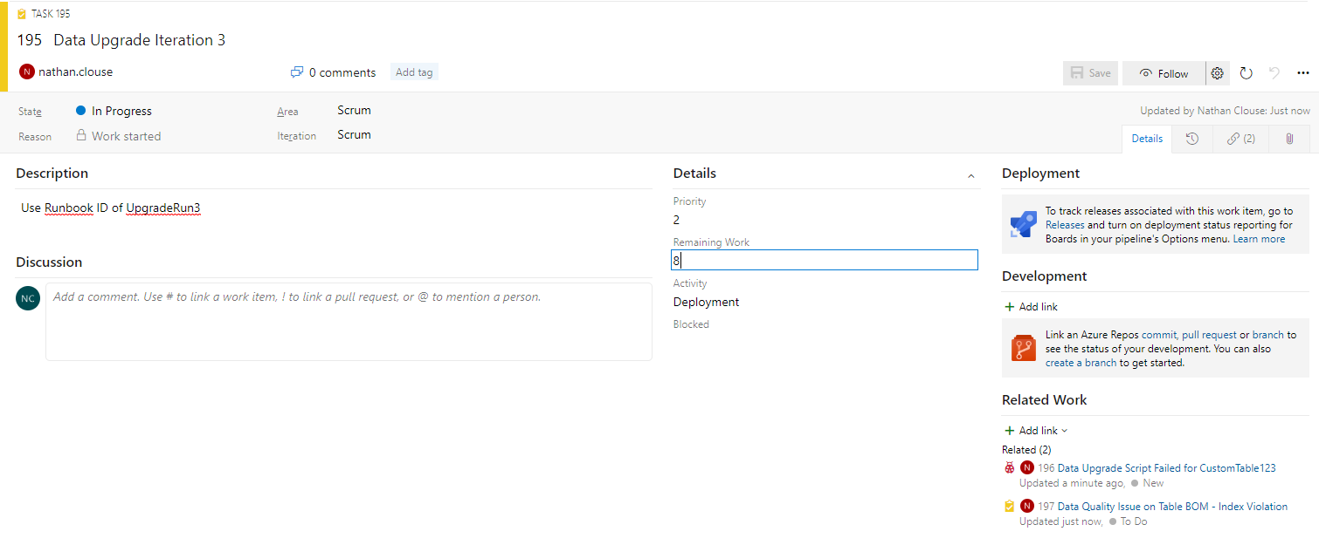

Slide 37
Troubleshooting

Slide 38
Troubleshooting
Skip Failed Scripts
Can help identify more errors than just the first one that fails an upgrade
https://docs.microsoft.com/en-us/dynamics365/fin-ops-core/dev-itpro/migration-upgrade/upgrade-data-to-latest-update#skip-failed-scripts
Known Issues
https://docs.microsoft.com/en-us/dynamics365/fin-ops-core/dev-itpro/migration-upgrade/upgrade-data-to-latest-update#known-issues
Notes:
Call out to skip failed scripts on the first few runs just to get through the process and collect what errors you may have
Also, review known issues. If they apply to you, a solution is given which you should incorporate into your organizations process

Slide 39
Troubleshooting
Check LCS
Some errors are version dependent so you may have to start with a different version
May be fixed in quality update
Some weirdness may be ok
Solve problems pragmatically
Notes:
If you run into an issue that isn’t on the known issues list but doesn’t look like its an issue with your data, Do an issue search on LCS. Sometimes they will fix issues with a quality update KB. They may also have issues and work arounds not yet confirmed by the product group that you can pull from LCS and use in your project. Examples would be manually adding a temporary index to speed up a process, prevent SQL dead locking, etc.
If you run into a weird issue, see if applying a quality update corrects it. If not, review it and find root cause. As a real world example, I had a client that had 1 record in their customer table that didn’t want upgrade for undetermined reasons. On review, the customer record had never been used on a transaction so we just decided to delete the customer from AX 2012 and move on. That “solved” that issue. We didn’t find root cause but deleting a place holder style customer fixed it so we could continue making progress.

Slide 40
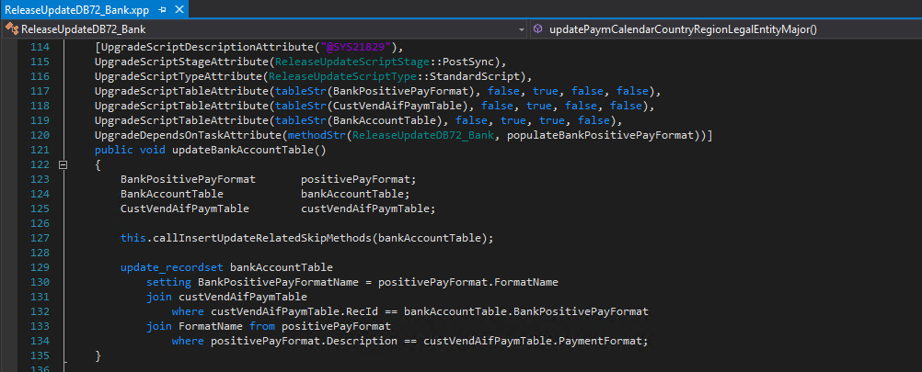
Troubleshooting - Updates
Notes:
This is one way to write an update script. These scripts can be complex and may not be tuned for your specific data presentations in your organization. Ie; this upgrade script may work well I fyou have less than 100 bank accounts but may be really slow if you have 10M bank accounts. This is a set-based style of update script but may require some review on indexing if this runs slowly. This will actually update data – change values in the database – during the upgrade process.
As a call out, all related business logic on the tables will be called unless specifically disabled like the call on line 127

Slide 41
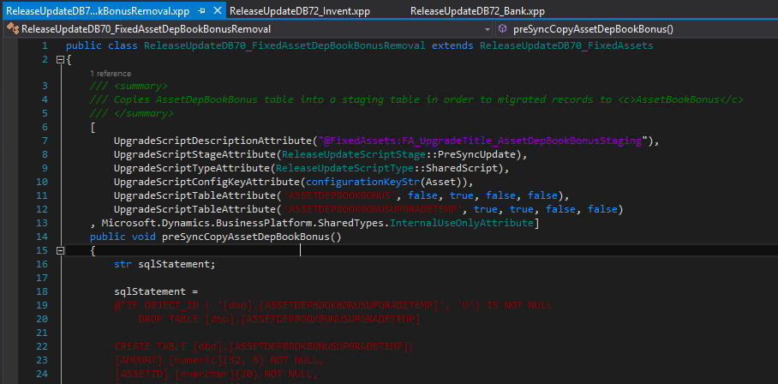
Troubleshooting – Presync Update
Notes:
Another style and type of an update script. This is a SQL based script that executes before the data upgrade process starts trying to convert your database form the AX 2012 format to the F&O format. This is using SQL to create a table to store some data related to fixed assets. This is setting aside data to be processed later. The table created here will be consumed by another upgrade script later in the process.

Slide 42
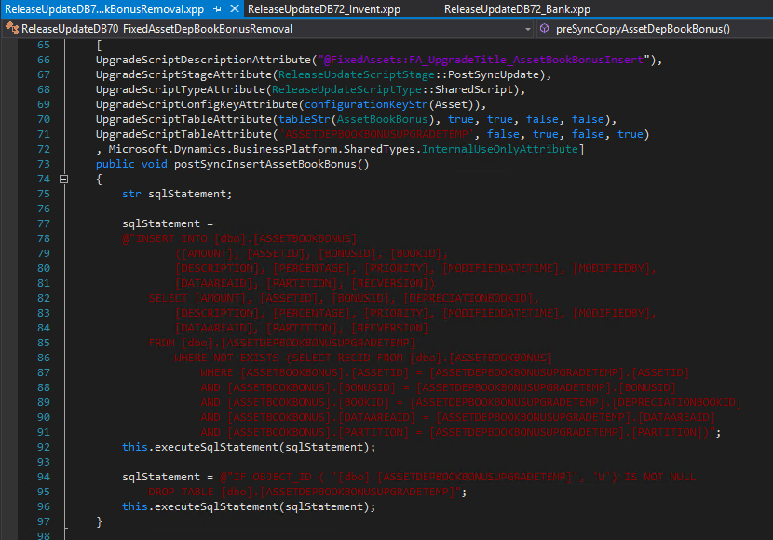
Troubleshooting – PostSync Insert
Notes:
Another type of upgrade script. This is the second half of the example right before this. It is INSERTing data into an F&O table from the prepared temporary upgrade table. This is an example of a large rewrite of the underlying data architecture inside F&O so the full process, the last script plus this script, is taking data from an AX table, putting it into a temporary upgrade table, dropping the AX table, inserting that temporary data into a newly re-structured F&O table then dropping that temporary upgrade table. This is what you would have to do If your data architecture in your customizations is changing drastically.

Slide 43
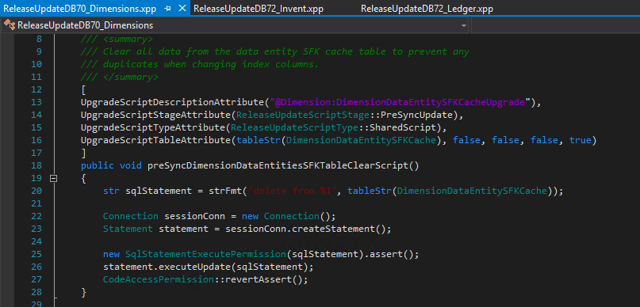
Troubleshooting - Delete
Use Truncate
Notes:
You can also delete data during the upgrade. Typically there are some cache tables that get emptied and rebuild later so if you see a DELETE FROM statement, its not a major worry.
However, if you are doing this with custom tables or script, you can use TRUNCATE TABLE if you want. Its faster but its not in a transaction. DELETE FROM is in a transaction but can be slow if you have lots of data as the transaction will record before and after state in the log. That’s just more overhead.

Slide 44
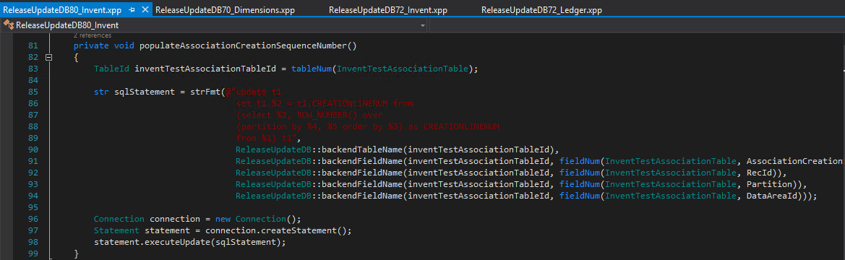
Troubleshooting – SQL Functions
Notes:
If your data are changing and you want to use SQL functions, you can. This is an example of how to use SQL to create line numbers for a table that didn’t have line numbers without having to loop through each parent and child line to determine what value to update each line with.

Slide 45
Logging
The Runbook will have a folder where everything gets logged
C:\Temp\MajorVersionDataUpgradePackage\RunbookWorkingFolder\MyRunbook42\Contoso-DBU-1\AOSService\8\Log
Temp Directory – C:\Temp
Deployable Package – MajorVersionDataUpgradePackage
MyRunBook42 – Runbook ID generated for this iteration
Contoso-DBU-1 – Machine DNS name
8 – Runbook Step id
ps> Get-Content –Wait FullDBSync.log
Notes:
When running the upgrade deployable package locally, here is how you find all of the log files that are generated.
C:\Temp\MajorVersionDataUpgradePackage is the deployable package directory
RunbookWorkingFolder is the default folder for logs to go for a deployable package
You can use Powershell to watch a log file in real time so you can get an idea of what each database upgrade step is doing

Slide 46
Logging
Also look at tables ReleaseUpdateJobStatus, ReleaseUpdateScriptsErrorLog, ReleaseUpdateScriptsLog
Also look in Event Viewer
Applications and Services Logs > Microsoft > Dynamics > AX-DataUpgrade
Applications and Services Logs > Microsoft > Dynamics > AX-DatabaseSynchronize
Notes:
Tables to look at / query peridocially if it appears that nothing is happening. Things are happening but some processes provider very little output so check these tables
Similarly, some processes write messages to the event viewer only so check there to get an idea of what is happening

Slide 47
Upgrade Scripts Examples
[UpgradeScriptDescriptionAttribute("@SYS53630"),
UpgradeScriptStageAttribute(ReleaseUpdateScriptStage::PostSync),
UpgradeScriptTypeAttribute(ReleaseUpdateScriptType::StandardScript),
UpgradeScriptTableAttribute(tableStr(InventDim), false, true, true, false)]
public void moveCustomInventDimFields()
{
InventDim Inventdim;
update_recordset inventDim
setting InventDimension1 = Inventdim.MyContainerId,
InventDimension2 = Inventdim.MySampleId;
}
Notes:
Example of copying values from some custom fields into OOTB fields. This was some custom inventory dimension that were added in 2012 but have been moved into the OOTB optional expansion inventory dimensions from MSFT.

Slide 48

[UpgradeScriptDescriptionAttribute("@SYS53630"),
UpgradeScriptStageAttribute(ReleaseUpdateScriptStage::PostSync),
UpgradeScriptTypeAttribute(ReleaseUpdateScriptType::StandardScript),
UpgradeScriptTableAttribute(tableStr(ProjWorkerSetup), false, true, true, false)]
public void updateProjWorkerSetup()
{
DataArea dataarea;
ProjWorkerSetup ProjWorkerSetup;
HcmWorker HCMWorker;
while select dataarea where dataarea.isVirtual == NoYes::No
{
changecompany(dataarea.id)
{
ProjWorkerSetup = null;
while select forUpdate ProjWorkerSetup
{
if(!HcmWorker::exist(ProjWorkerSetup.Worker))
{
ttsBegin;
ProjWorkerSetup.delete();
ttsCommit;
}
}
}
}
}
Notes:
Example of a data cleanup script that executes during database upgrade. In short, I had some data with broken relationships. This script goes through and validates that relationships. If it isn’t able to validate the relationship, it deletes the record. This was causing some issues later in the process so we added this cleanup script. This could have also been performed in AX 2012 as a job.

Slide 49
while select dataarea where dataarea.isVirtual == NoYes::No
{
changecompany(dataarea.id)
{
ProjWorkerSetup = null;
while select forUpdate ProjWorkerSetup
{
if(!HcmWorker::exist(ProjWorkerSetup.Worker))
{
ttsBegin;
ProjWorkerSetup.delete();
ttsCommit;
}
}
}
}

Slide 50
[UpgradeScriptDescriptionAttribute("@SYS53630"),
UpgradeScriptStageAttribute(ReleaseUpdateScriptStage::PostSync),
UpgradeScriptTypeAttribute(ReleaseUpdateScriptType::StandardScript),
UpgradeScriptTableAttribute(tableStr(ProjWorkerSetup), false, true, true, false)]
public void updateProjWorkerSetup()
{
DataArea dataarea;
ProjWorkerSetup ProjWorkerSetup;
HcmWorker HCMWorker;
while select dataarea where dataarea.isVirtual == NoYes::No
{
changecompany(dataarea.id)
{
ProjWorkerSetup = null;
while select forUpdate ProjWorkerSetup
{
if(!HcmWorker::exist(ProjWorkerSetup.Worker))
{
ttsBegin;
ProjWorkerSetup.delete();
ttsCommit;
}
}
}
}
}

Slide 51
[UpgradeScriptDescriptionAttribute("Populate NewVendorStatus Table"),
UpgradeScriptStageAttribute(ReleaseUpdateScriptStage::PostSync),
UpgradeScriptTypeAttribute(ReleaseUpdateScriptType::StandardScript),
UpgradeScriptTableAttribute(tableStr(NewVendorStatus), true, true, true, false),
UpgradeScriptTableAttribute(tableStr(OldVendorStatus), false, true, false, false)]
public void populateTableNewVendorStatus()
{
NewVendorStatus NewVendorStatus;
OldVendorStatus OldVendorStatus;
insert_recordset NewVendorStatus (NewVendorStatusId, Description)
select StatusId, Description from OldVendorStatus;
}
Notes:
This is a script to copy some data from an ISV table, oldVendorStatus, into a new custom table, NewVendorStatus. This can be used when you have some ISV related data you want to keep after the upgrade but you do not plan to keep that ISV as part of the upgrade.

Slide 52
Removing and Adding a Field
const str oldFieldName = 'Date';
const str newFieldName = fieldStr(MyTable, TransDate);
ReleaseUpdateDB_GLSHelper::replaceTableField(tableStr(MyTable), oldFieldName, newFieldName);
Notes:
Example of how to replace a field on table. This will not actually create either column. It assumes a sync has already created the new column. This will copy the data from 1 field to another. In this instance this would update MyTable.TransDate to be equal to MyTable.Date. A database sync later in the process will handle dropping the “date” field so only TransDate is left.

Slide 53
Renaming a Field
SysDictTable sysDictTable = new SysDictTable(_tableId);
ReleaseUpdateDB_GLSHelper::executeSqlStatementUpdate(
strFmt("EXEC sp_rename '%1','%2'",
sysDictTable.name(DbBackend::Sql),
_oldNameSQL));
Notes:
This will structurally rename a field on a table from 1 to 2.

Slide 54
SQL Based changes
[UpgradeScriptDescriptionAttribute("@SYS53630"),
UpgradeScriptStageAttribute(ReleaseUpdateScriptStage::PostSync),
UpgradeScriptTypeAttribute(ReleaseUpdateScriptType::StandardScript),
UpgradeScriptTableAttribute(tableStr(InventDim), false, true, true, false)]
public void moveCustomInventDimFields()
{
sqlStatement = @"UPDATE inventDim set InventDimension1 = Inventdim.MyContainerId,
InventDimension2 = Inventdim.MySampleId";
this.executeSqlStatement(sqlStatement);
}
Notes:
If you have large volumes of data to update, you can use SQL if you prefer. No business logic will execute related to the table(s) updated so be careful when using this option and know exactly what won’t be happening if you use SQL rather than X++ for the updates.

Slide 55
[UpgradeScriptDescriptionAttribute("Update Purchase Order Lines"),
UpgradeScriptStageAttribute(ReleaseUpdateScriptStage::PostSync),
UpgradeScriptTypeAttribute(ReleaseUpdateScriptType::StandardScript),
UpgradeScriptTableAttribute(tableStr(PurchLine), false, true, true, false)]
public void MoveValuesToforPurchLine()
{
PurchLine PurchLine;
PurchLine.skipAosValidation(true);
PurchLine.skipBusinessEvents(true);
PurchLine.skipDatabaseLog(true);
PurchLine.skipDataMethods(true);
PurchLine.skipEvents(true);
update_recordset PurchLine
setting NewSomeId = PurchLine.OldSomeId;
}
Notes:
This is an example of a script that will update all PurchLine records setting NewSomeID qual to OldSomeID. This can be useful when moving data an ISV to a custom model. This method specifically calls out to not call any validation, it will skip business events, database log, data methods and events if any of those are configured. In this instance, we just want to move data from 1 field to another with no additional business logic being executed.

Slide 56
Empty a Table
[UpgradeScriptStageAttribute(ReleaseUpdateScriptStage::PreSyncUpdate),
UpgradeScriptTypeAttribute(ReleaseUpdateScriptType::SharedScript),
UpgradeScriptTableAttribute(tableStr(MyTable), false, false, false, true)]
public void preSyncMyTableClearScript()
{
str sqlStatement = strFmt('delete from %1', tableStr(MyTable));
Connection sessionConn = new Connection();
Statement statement = sessionConn.createStatement();
new SqlStatementExecutePermission(sqlStatement).assert();
statement.executeUpdate(sqlStatement);
CodeAccessPermission::revertAssert();
}
Notes:
Example of how to empty a table

Slide 57
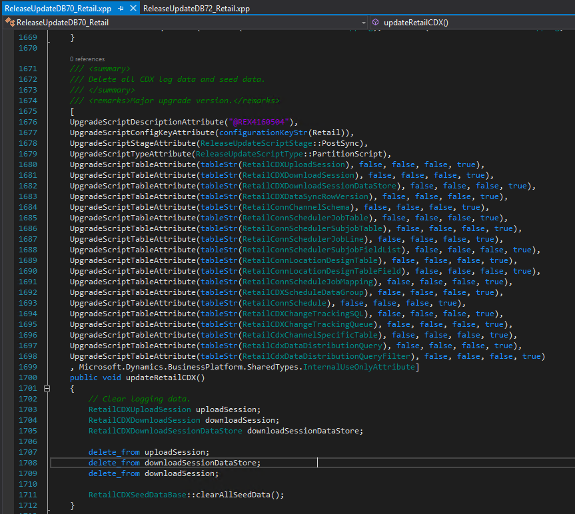
My Favorite Upgrade Script…

Slide 59
My Favorite Upgrade Script…

Slide 60
Questions?
Upgrade Process
How to Upgrade your data
Troubleshooting
How to Re-organize your data
Writing Upgrade scripts

Slide 61
Dynamics 365: Let’s talk Upgrade Rollout Approach (AX 2012 Upgrade Series: Part 6) – Tuesday @ 2:00
Dynamics 365 F&O Licensing, Upgrades, Costs and More (Part 2) – Tuesday @ 3:00
Retail and Warehousing: The Biggest Areas for Change in Dynamics 365 F&O (AX 2012 Upgrade Series: Part 3) – Wednesday @ 9:30
AX Sucks. Let’s talk Upgrades (AX 2012 Upgrade Series: Part 1)– Wednesday @ 10:30
An AX2012 Upgrade Journey - Wednesday @ 11:30
Dynamics 365 F&O Business Events From End to Start to End – Wednesday @ 1:40
Dynamics 365 F&O Upgrade Tech Talk: Code, Customizations, Extension and Power Platform (AX 2012 Upgrade Series: Part 5) – Thursday @ 10:00
How To Get The Most Out of Your Upgrade (AX 2012 Upgrade Series: Part 2) – Thursday @ 1:10

Slide 62
My Other Presentations
Dynamics 365 F&O Business Events From End to Start to End – Wednesday @ 1:40
Dynamics 365 F&O OData From Zero To Hero – Thursday @ 9:00
F&O Integration Roundup - Thursday @ 11:00
X++ Development Tips and Tricks plus D365FO.Tools! – Thursday @ 2:10

Slide 63
Give Away!

Slide 64

Please visit our booth
enVista booth #700
Meet with our experts
Learn about industry-leading practices
Get the most from your Microsoft investments
Register to win a YETI™ cooler
enVista
Booth
Hall C Entry

Slide 65

Survey Code

